Slide 1

Karla Červar Fotis Alatas
21.09.2021.
Fontys university of applied sciences

Slide 2
"ActiveMQ is an open source, Java Message Service (JMS) 1.1–compliant, message-oriented middleware (MOM) from the Apache Software Foundation that provides high availability, performance, scalability, reliability, and security for enterprise messaging."
- ActiveMQ in Action

Slide 3

Introduction:
Presentation
What is ActiveMQ
When to use
Java messaging service
Examples
Demo
Excercise
Quizz

Slide 4
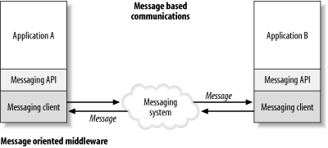

Message oriented Middleware
Message Oriented Middleware is a concept that involves the passing of data between applications using a communication channel that carries self-contained units of information (messages).
https://www.oreilly.com/library/view/enterprise-service-bus/0596006756/ch05.html

Slide 5
WHEN?
WHY?
In 2003, group of open source developers got together to form Apache Geronimo, they realized there is no good message broker.
Most of the MOMs in the market were commercial, closed source, and were costly to buy and support

Slide 6
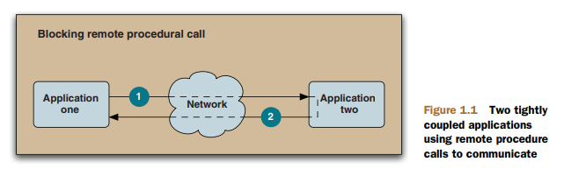
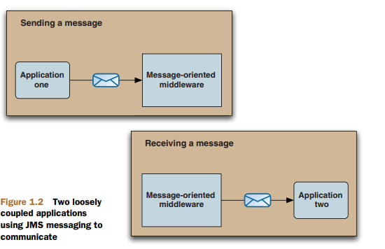
HOW?
Applications can rely on ActiveMQ to deliever messages
Applications do not have knowledge of the other ones

Slide 7
WHEN TO USE?
Heterogeneous application integration
As a replacement for RPC
To loosen the coupling between applications
As the backbone of an event-driven architecture
To improve application scalability

Slide 8
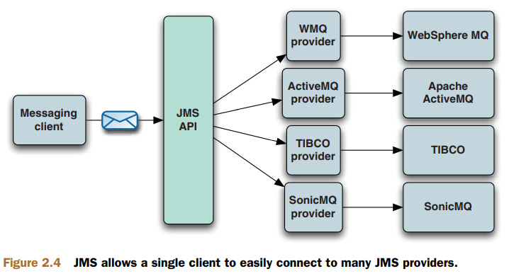
Java message service (JMS)
JMS is an API that abstracts the interaction between messaging clients and MOMs

Slide 9
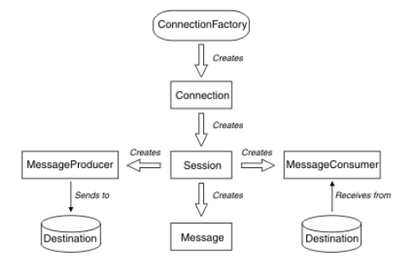
JMS concepts
Destination
where an application sends messages
ConnectionFactory
set of configuration properties for a connection
Connection
encapsulates an application's active connection to a messaging server,creates sessions
Session
single threaded context for sending and receiving messages. create messages, producers, and consumers.
Message
object that encapsulates a message
MessageProducer
used to send messages
MessageConsumer
used to recieve messages
https://www.ibm.com/docs/en/ibm-mq/9.1?topic=applications-jms-model

Slide 10
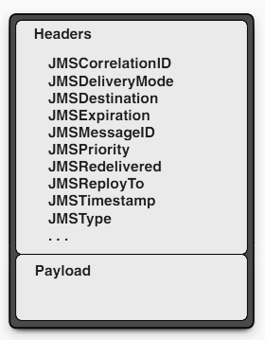
JMS message
-every concept is built around handlling a JMS message
Header
JMSDelieveryMode: persistend(Default) and nonpersistend
JMSExpiration: does not deliever message if expired
JMSPriority: 0 (lowest) - 9 (highest)
Optional:
JMSCorrelationID: relation to previous message
JMSReplyTo: specify where a reply must be sent
JMSType: used to identify the message type, not the payload type
Additional headers - Properties:
possibility to define any additional property using any Java type
types of properties: custom properties, JMS defined properties, and provider-specific properties

Slide 11
Message selectors
JMS message selectors to tell the JMS provider that it only wants to receive messages containing a particular value in a particular property.
Example:
String selector = "SYMBOL IN ('AAPL', 'CSCO') AND PRICE > " + getPreviousPrice() + " AND PE_RATIO < " + getCurrentAcceptedPriceToEarningsRatioThreshold();
MessageConsumer consumer = session.createConsumer(destination, selector)

Slide 12
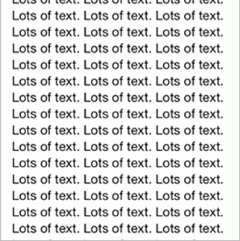
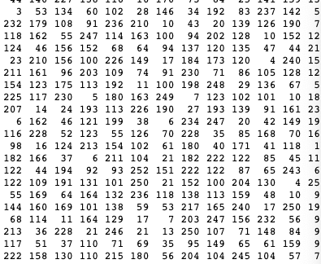
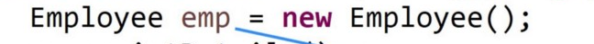
Message payload
Message
Payload: no payload, only headers and properties
Text Message
Payload: String
Map Message
Payload: name(string)/value(Java primitive type) pairs
Bytes Message
Payload: an array of uninterpreted bytes
Stream Message
Payload: a stream of primitive Java types that’s filled and read sequentially
Object Message
Payload: serializable Java object

Slide 13
ActiveMQ features:
JMS Copliance
Connectivity
Pluggable persistance and security
Building message applications with Java
Integration with application servers
Broker clustering
Many advanced broker features and client options
Dramatically simplified administration
Client APIs
2

Slide 14
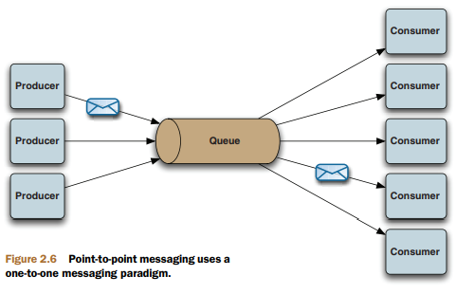
JMS domains
Two styles of messaging:
point - to - point
publish/subscribe
THE POINT-TO-POINT DOMAIN
uses destinations known as queues
synchronously or asynchronously
messages delievered only once
and to a single consumer
round-robin style across all the
registered consumers

Slide 15
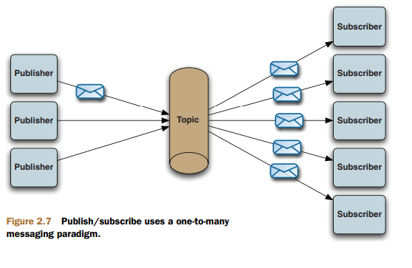
PUBLISH/SUBSCRIBE
destinations known as topics
messagess are delievered to all subscribers
synchronously or asynchronously
durable subscription - if a durable subcriber disconnects, JMS provider will hold all messages until that subscriber connects again
nondurable subscription - does not hold any messages

Slide 16
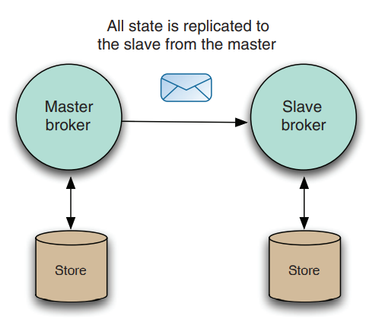
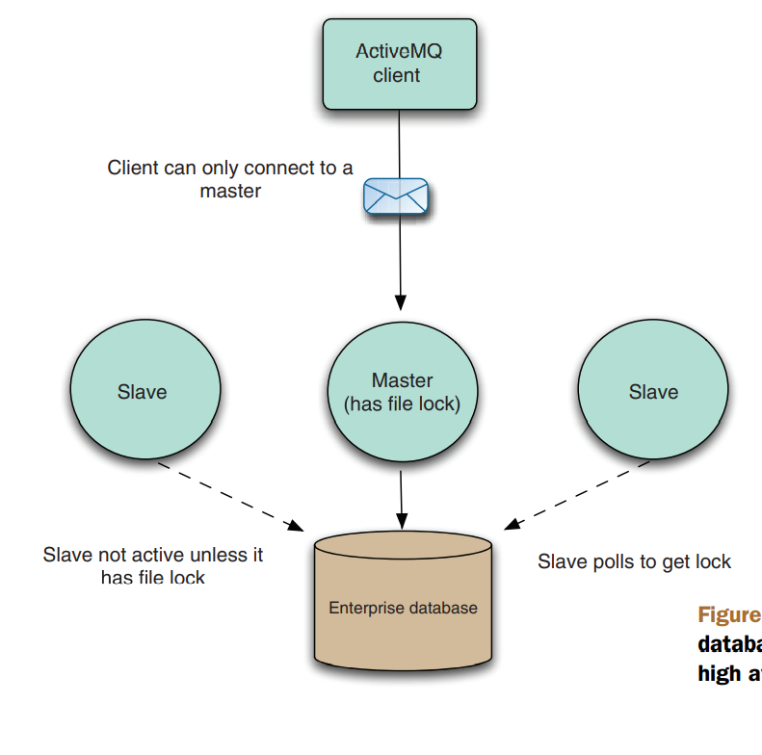
Advanced features in ActiveMQ
High availability
run multiple ActiveMQ brokers on different machines - if one fails the other one takes over
master/slave
One broker primary/master and the other ones are are waiting for it to fail
Java and C++ have built in failover transfer.
Two types of master/slave:
Shared nothing master/slave
Shared storage master/slave

Slide 17
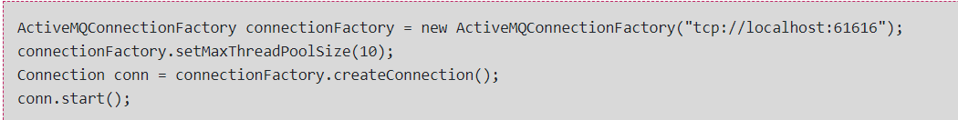
Deploying ActiveMQ for large numbers of concurrent applications
Vertical scaling
by default there is one thread
allocated by every session
Now:
maximum of 1000 threads by default
configure an appropriate amount of the memory available
Horizontal scaling
failover://(tcp://broker1:61616,tcp://broker2:61616)?randomize=true
use networks to increase the number of ActiveMQ brokers available for your applications
configure your clients to connect to a cluster of brokers, selecting one at random to connect to
<networkConnector uri="static://(tcp://remotehost:61617)"
name="bridge"
dynamicOnly="true"
prefetchSize="1"
</networkConnector>

Slide 18
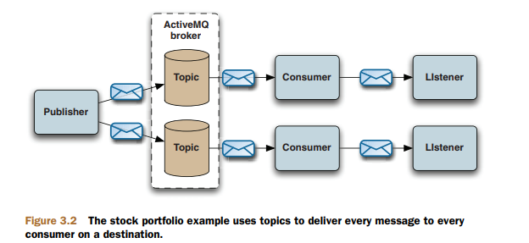
Example 1
publish/subscribe messaging
Publisher class for sending stock price messages to a topic
Consumer class for registering a Listener class to consume messages
asynchronous manner

Slide 19
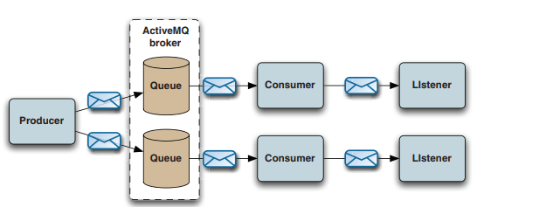
Example 2
point-to-point messaging
Producer class to send job messages to a job queue
Consumer class for registering a Listener class to consume messages from queues
asynchronous manner

Slide 20
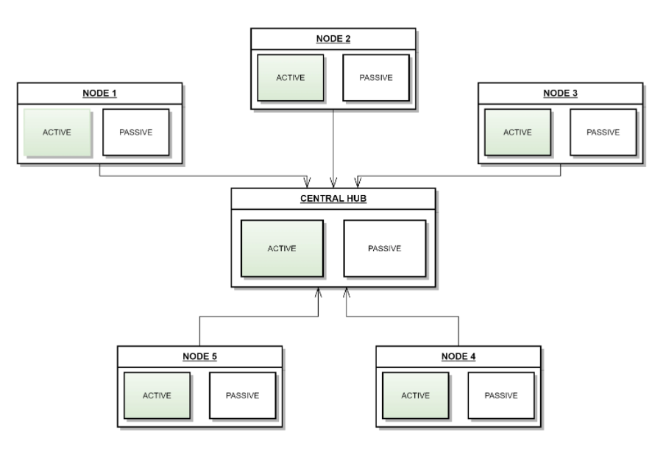
Example 3
large, global manufacturing company
PROBLEM: consolidating the data produced by each factory, and effectively using that data to help improve their business intelligence without replacing their mainframes
added a message producer to each mainframe, which pushed data into ActiveMQ. There, the data was aggregated into a data lake, where it gets processes and converted into a dashboard
https://www.openlogic.com/blog/activemq-examples

Slide 21
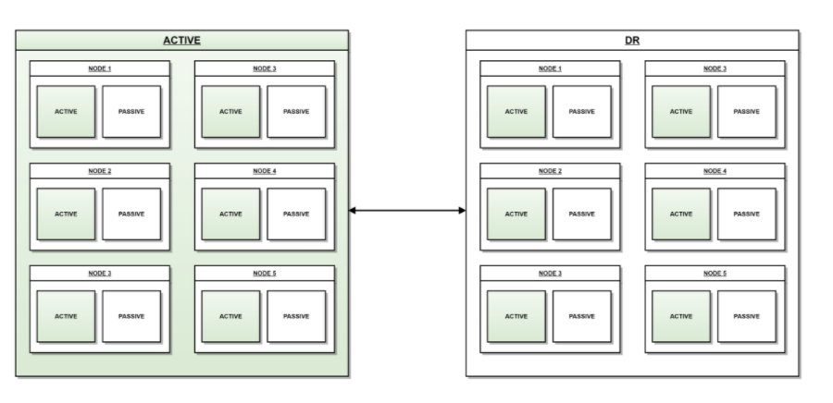
Example 4
public transit authority, specifically a company that manages a network of trains. The company requires a highly available, highly redundant system that can communicate network status at all times
eployed a highly available and redundant system consisting of 12 servers per location (six active, six passive) with between five and ten applications per node.
https://www.openlogic.com/blog/activemq-examples

Slide 22
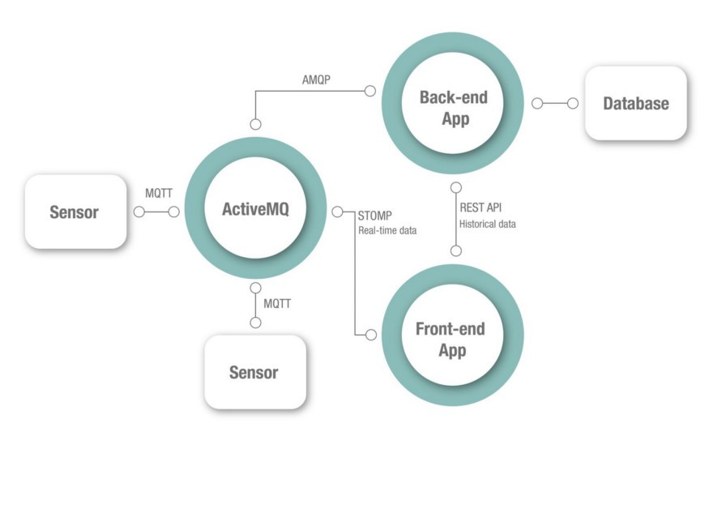
Example 5
Home smart sensors in your house that send data via MQTT, a back-end server that receives the information from the message broker via AMQP. It then stores the data measured by your sensors in a database and a web dashboard that’s connected to the same message broker via Stomp and displays the values in real-time.
If you are a business that develops smart devices that connected through a mobile or web application, this architecture will not only be a plus but will make the whole system reliable. In this way, the users will be able to monitor their data no matter where they are and know that no information is lost.
https://itnext.io/all-you-need-to-know-about-activemq-76edb977e6a

Slide 23


Advantages of ActiveMQ
Highly Scalable
Open Source
Easy to use
Broker Clustering
Supports multiple protocols like HTTP/HTTPS, STOMP, UDP for connectivity
Offers client APIs for multiple languages like Java, .Net, Python, Ruby, and many more languages.
It allows you to customize the authorization and authentication required for your communication as per your requirement or needs.
Provides reliable communication between the producer and consumers.

Slide 24

Disadvantages of ActiveMQ
Flexibility can be overwhelming when the chosen use case is not the default
Documentation is good however the info is not up-to date or info for specific use cases are difficult to be found
The website has decent documentation and snippets of code but they lack comprehensive examples/use cases
It needs to be tuned to get the benefit of speed and scalability
Lack of GUI controller like e.g. IBM MQ

Slide 25

Sources
ActiveMQ in Action by Bruce Snyder, Dejan Bosanac and Rob Davies
IBM - https://www.ibm.com/docs/en/ibm-mq/9.1?topic=applications-jms-model
https://www.openlogic.com/blog/activemq-examples
https://itnext.io/all-you-need-to-know-about-activemq-76edb977e6a
Further information
All inclusive ActiveMQ book: ActiveMQ in Action
How to Scale ActiveMQ: SlideShare
ActiveMQ Supported Protocols: Protocols

Slide 26
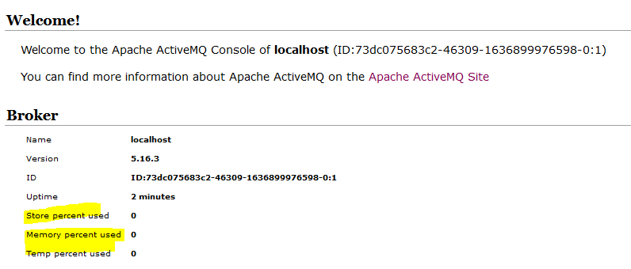
ActiveMQ storage
Store
% of assigned disk space that has been used up to store persistent messages (KahaDB)
Temp
Assigned of disk storage space %
Is used to store non-persistent messages
Memory
Amount of memory assigned to the broker to keep track of destinations.
Needs to be less than the JVM heap size
Source: DZone

Slide 27
What the columns mean
Pending messages – Number of currently messages waiting to be delivered
Enqueued messages – Number of messages waiting to be processed since the last reset.
Dequeued messages – Delivered messages to their consumers.
Equeued != Dequeued.
Source: stackoverflow

Slide 28
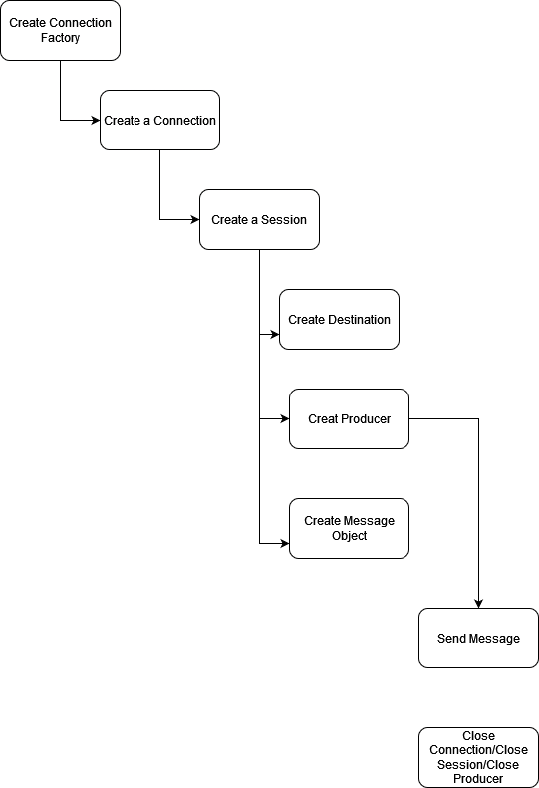
How to send a message with JMS

Slide 29
AUTO_ACKNOWLEDGE
The session automatically acknowledges each message received by the application.
If messages are delivered synchronously to the application, the session acknowledges receipt of a message every time a Receive call completes successfully. If messages are delivered asynchronously, the session acknowledges receipt of a message every time a call to the onMessage() method of a message listener completes successfully.
If the application receives a message successfully, but a failure prevents acknowledgment from occurring, the message becomes available for delivery again. The application must therefore be able to handle a message that is re-delivered.
DUPS_OK_ACKNOWLEDGE
The session acknowledges the messages received by the application at times it selects.
Using this acknowledgment mode reduces the amount of work the session must do, but a failure that prevents message acknowledgment might result in more than one message becoming available for delivery again. The application must therefore be able to handle messages that are re-delivered.
CLIENT_ACKNOWLEDGE
The application acknowledges the messages it receives by calling the Acknowledge method of the Message class.
The application can acknowledge the receipt of each message individually, or it can receive a batch of messages and call the Acknowledge method only for the last message it receives. When the Acknowledge method is called all messages received since the last time the method was called are acknowledged.
Source: Ibm.com
JMS Sessions Acknowledgment modes

Slide 30
What happens when a message is Acknowledged?
Once the broker receives signal that a message has been acknowledged it removes it from the persistence storage unit (KahaDB)

Slide 31
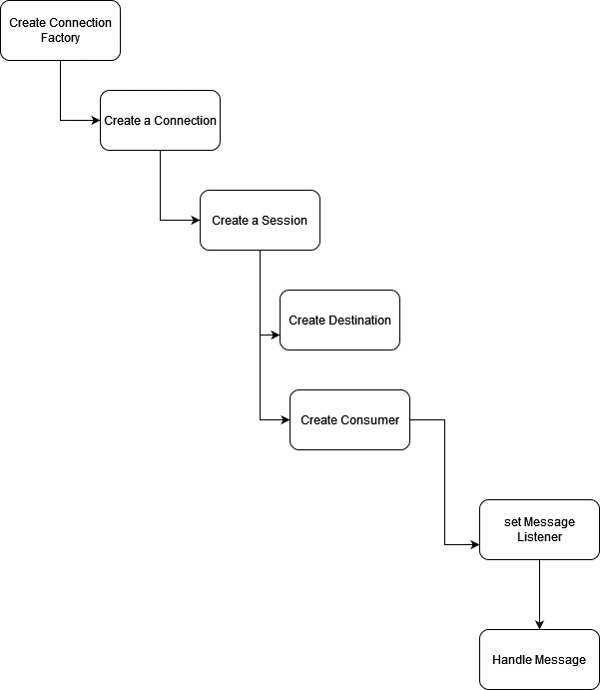
How to to receive a message with JMS

Slide 32
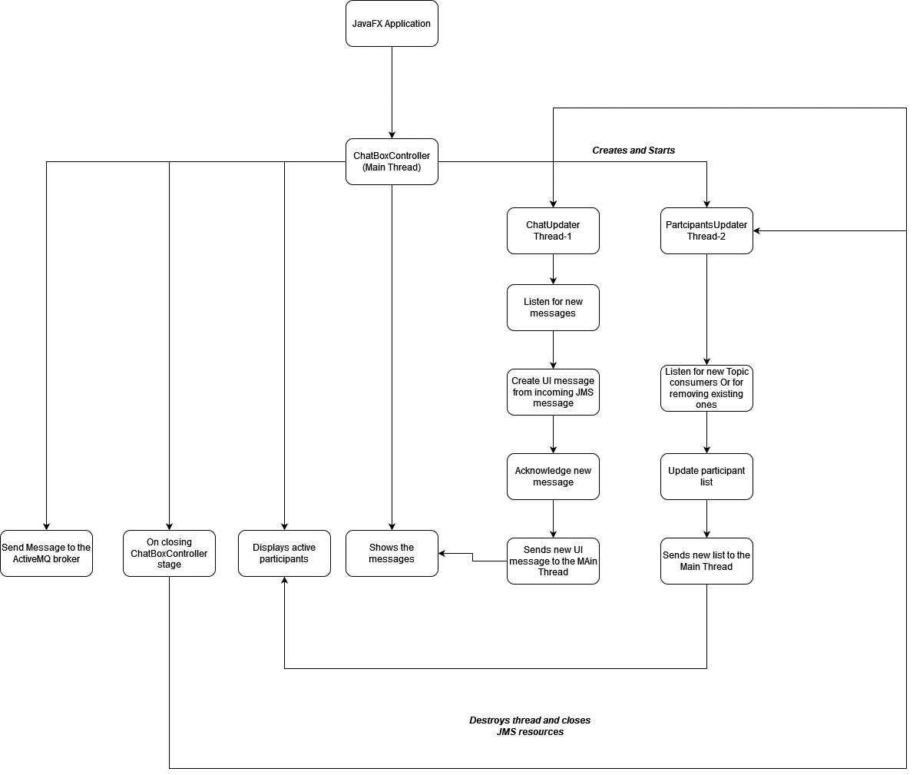
Main Functionality - ChatBoxController

Slide 33
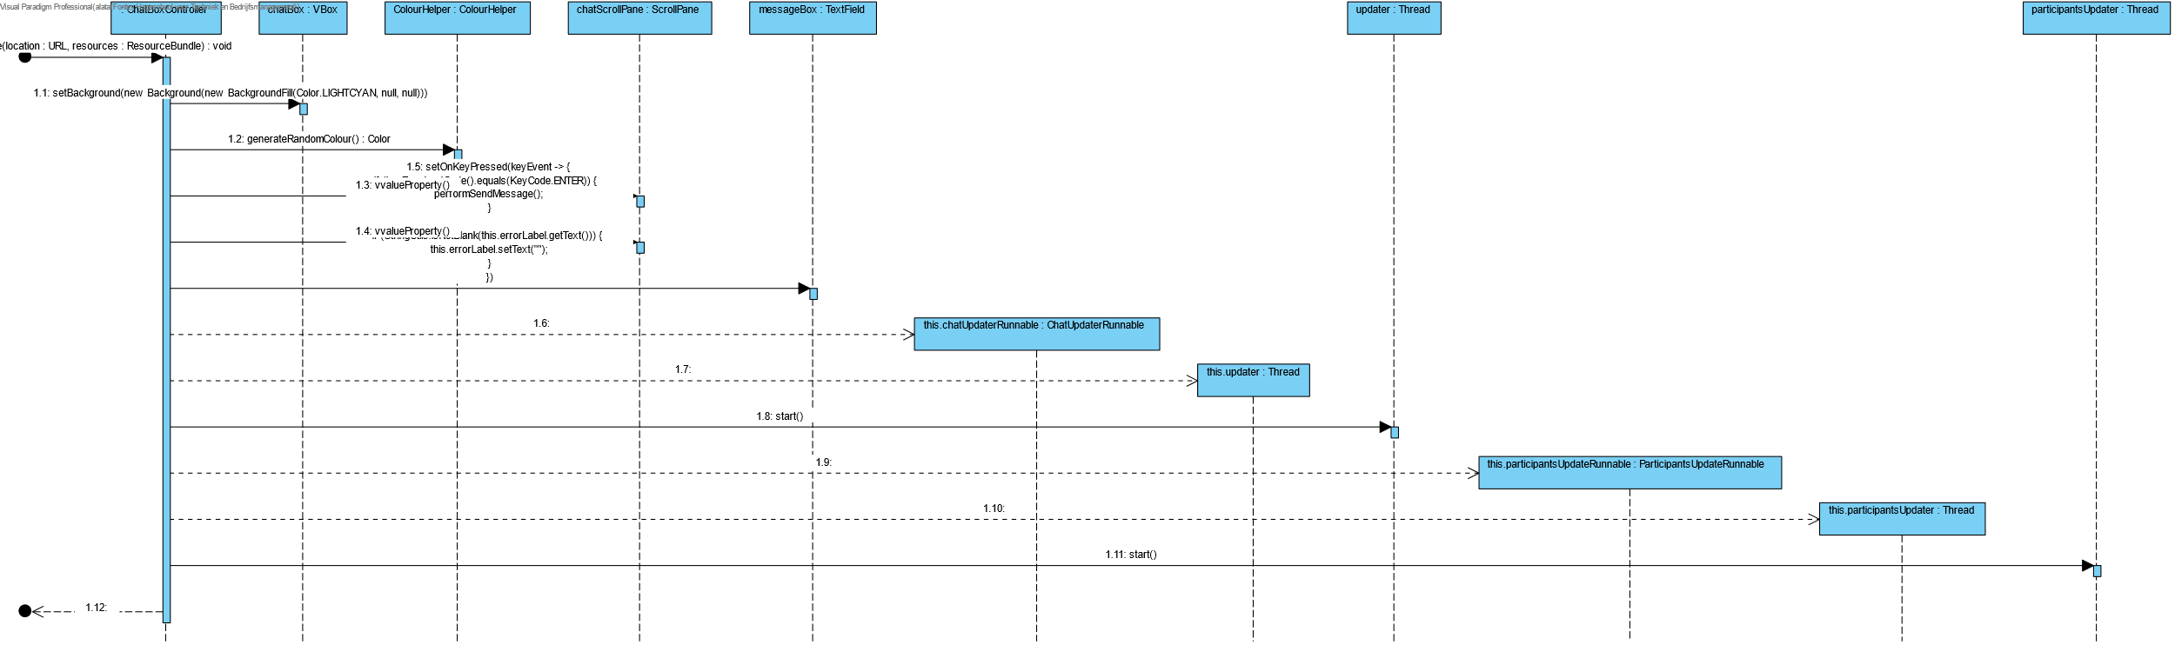
Thread creation

Slide 34
Exercises: Implement the code
Open the Chaty_Exercise project that exists in the git Repo
1st exercise open Class ActiveMQService and follow the instructions
2nd exercise open the ChatBoxController – line 143 and follow the instructions
3rd exercise open the ChatUpdaterRunnable and follow the instructions
4th exercise open the ActiveMQBrokerInfoRetrieverImpl class and follow the instructions
User the smaller examples that were provided before, your partner and don’t be afraid to ask questions

Slide 35
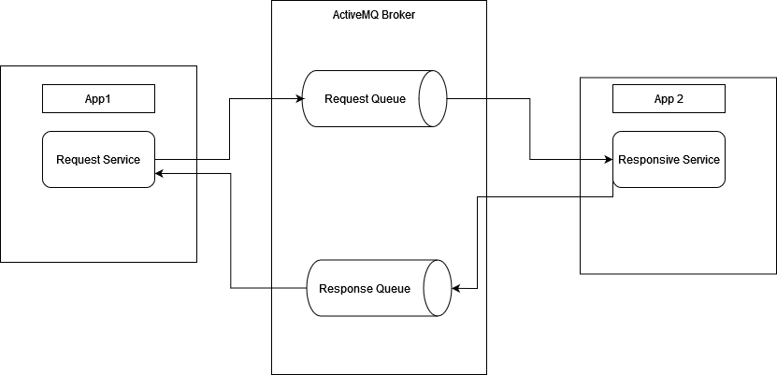
Request and Reply
Messaging Pattern
Really good for decentralized applications
Source: Enterprise Integration Patterns

Slide 36
Future of ActiveMQ
Current ActiveMQ 5.X
Will be replaced by ActiveMQ Artemis → ActiveMQ 6.X
ActiveMQ Artemis has more potential
source: activemq.apache.org

Slide 37

Questions?
Thank you for attention!

